Slide 1

Building a Chess Analysis Model Using Expert Systems + LLMs
From engine evaluations to human-like commentary

Slide 2
Table of content
intro
Expert systems
LLM
Chess coach
conclusion

Slide 3

Introduction
Chess is one of the hardest strategy games ever created.
Understanding positions and plans is not easy.
That’s why even strong players need guidance and why a good coach matters.

Slide 4
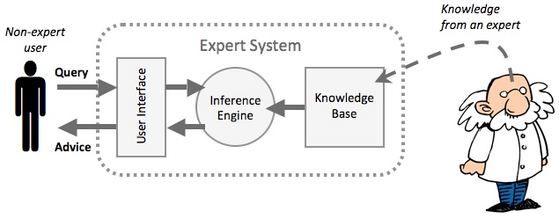
What is the expert system
Expert System:
A rule-based AI system
Uses knowledge from human experts
Applies logical rules to solve problems
One of the earliest forms of Artificial Intelligence

Slide 5
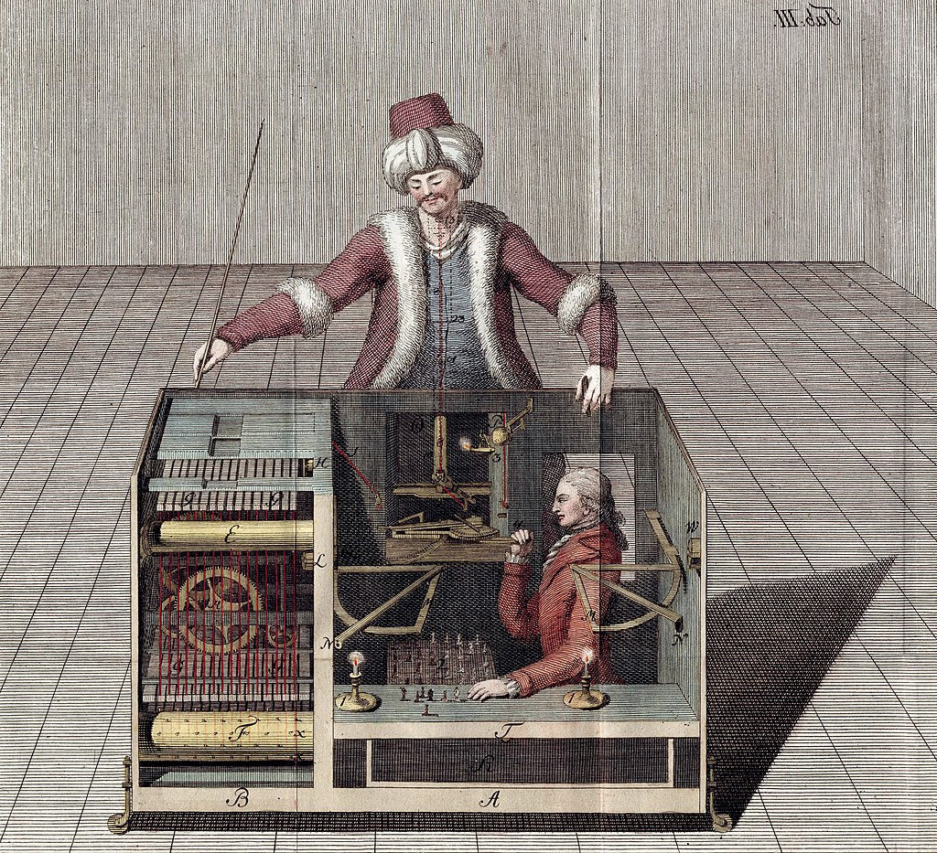
Chess engine history
1950s–1960s: First chess programs created using simple brute-force search.
1970s–1980s: Engines begin using minimax + alpha-beta pruning to search deeper.

Slide 6
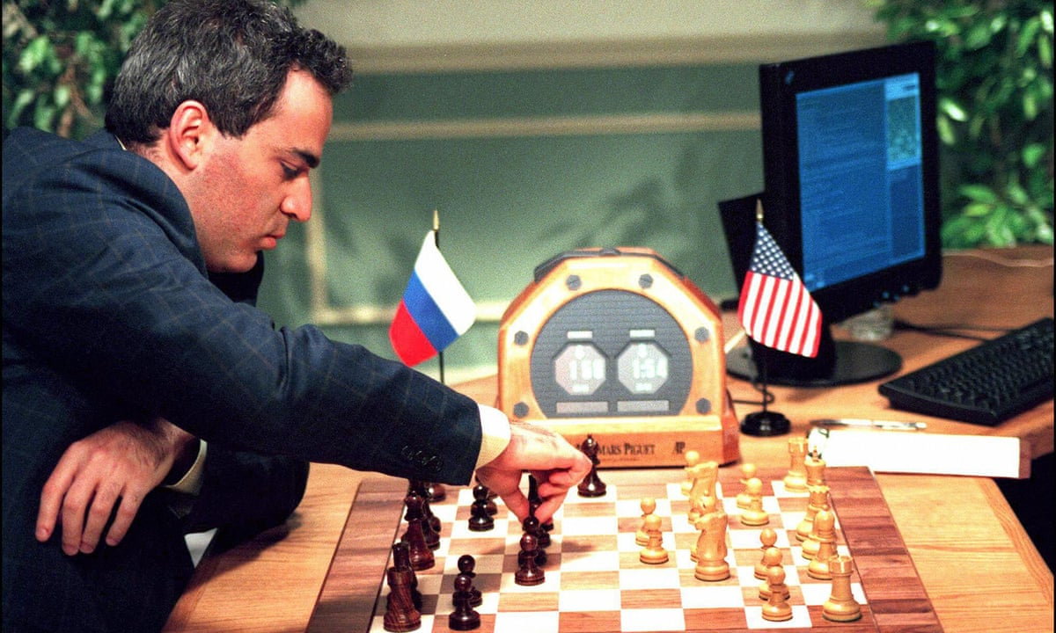
Deep blue
Chess engines are a very good chess players today
Deep Blue became the first machine to win a chess game against a reigning world champion under regular time controls.

Slide 7
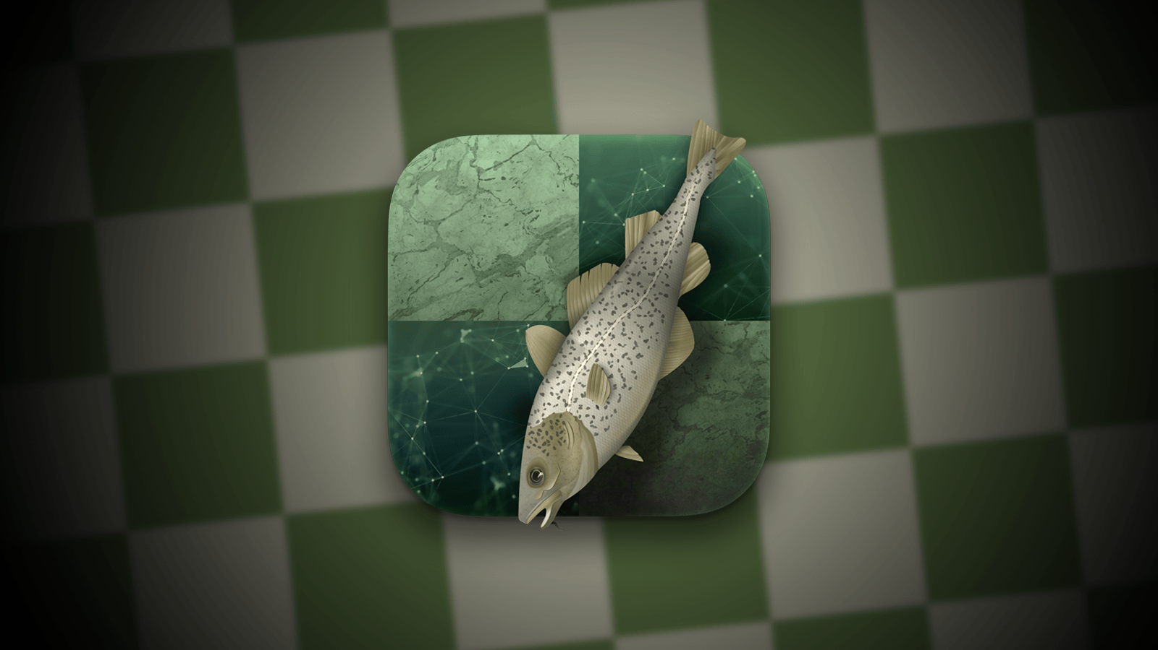
Stockfish
Search Algorithm: Alpha-Beta Pruning with Enhancements
Position Evaluation Function
  Material balance
  Piece-square tables
  Pawn structure
Neural Network Evaluation (NNUE)
Multithreading & SIMD Optimization
Transposition Table (TT)
3600-3700 ELO

Slide 8

Alpha zero
Pure self-play reinforcement learning
AlphaZero learns everything from scratch
AlphaZero combines:
  Monte Carlo Tree Search (MCTS) – for planning and exploration
  Deep Neural Network – to guide MCTS and evaluate positions
  Reinforcement Learning via Self-Play – to improve over time
3500-4000+ Elo

Slide 9
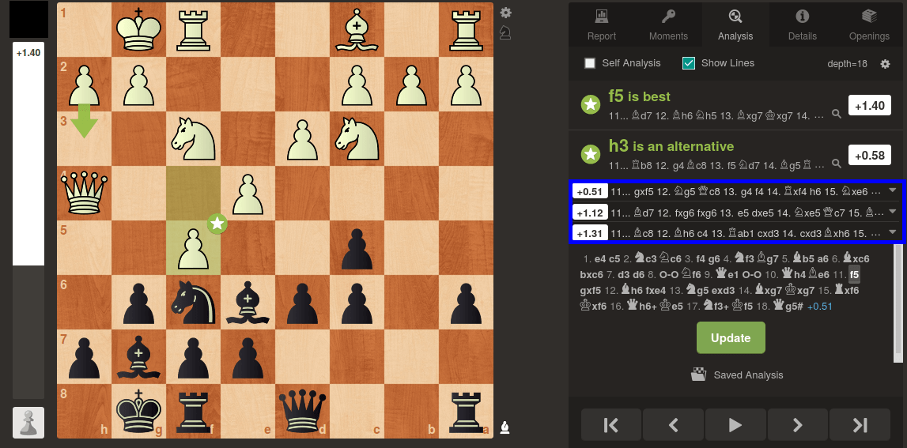
Chess engine evaluation
They can evaluate a position and assign a number to it.

Slide 10

How can we use them
As beginner player you can’t use this expert system outputs directly
because they are very complex and you don’t understand the expert thinking process

Slide 11
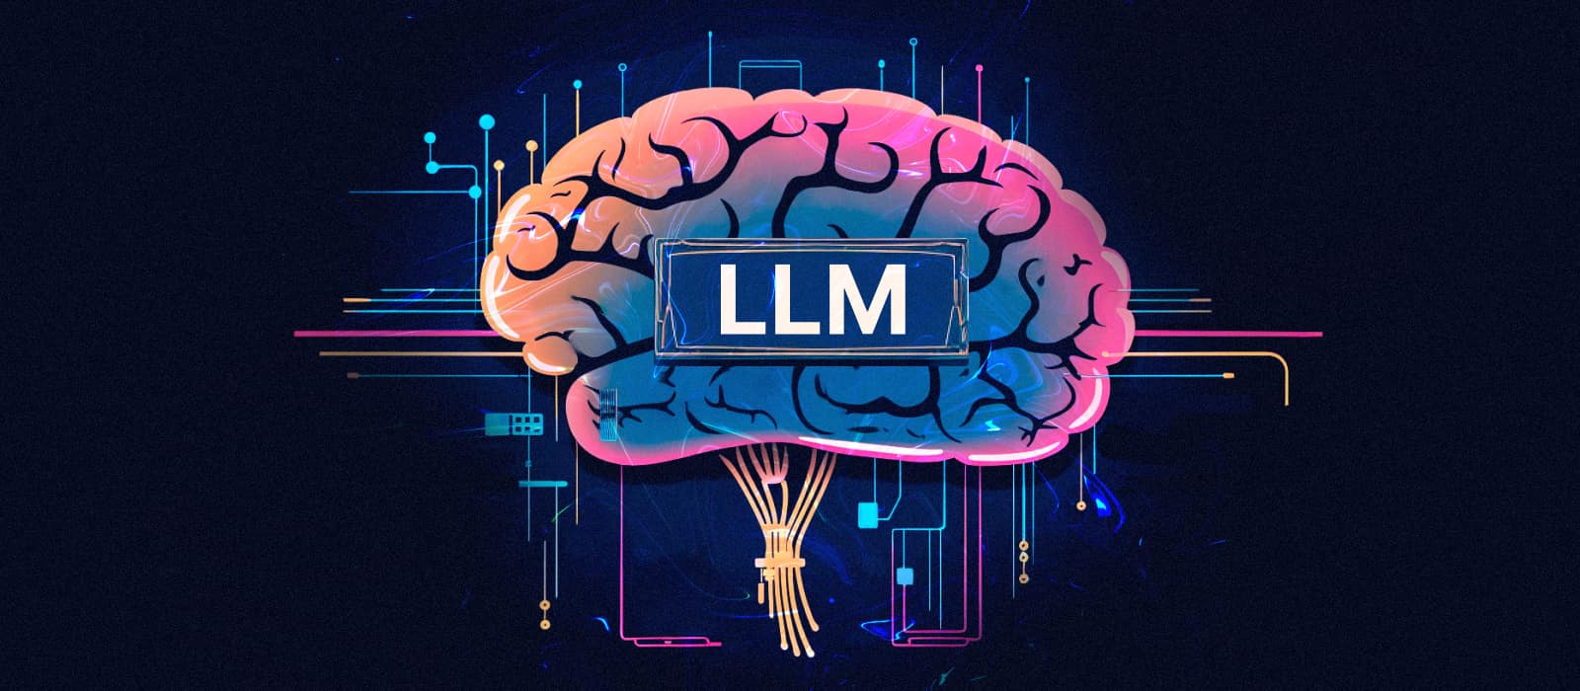
LLM
Nowadays, nearly everyone uses LLMs
LLMs can understand and generate human language very fluently.
LLMs are AI models trained on massive text datasets

Slide 12
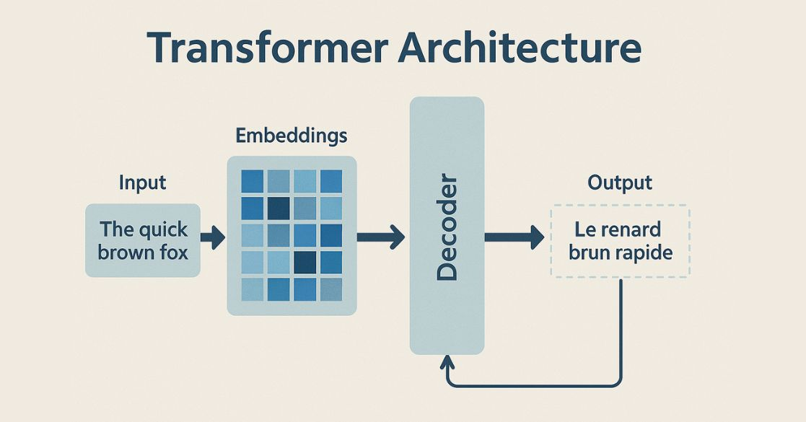
Transformer Architecture
Introduced in 2017 by 'Attention Is All You Need
Replaced RNNs and LSTMs with parallel processing
Uses self-attention to understand relationships between words

Slide 13
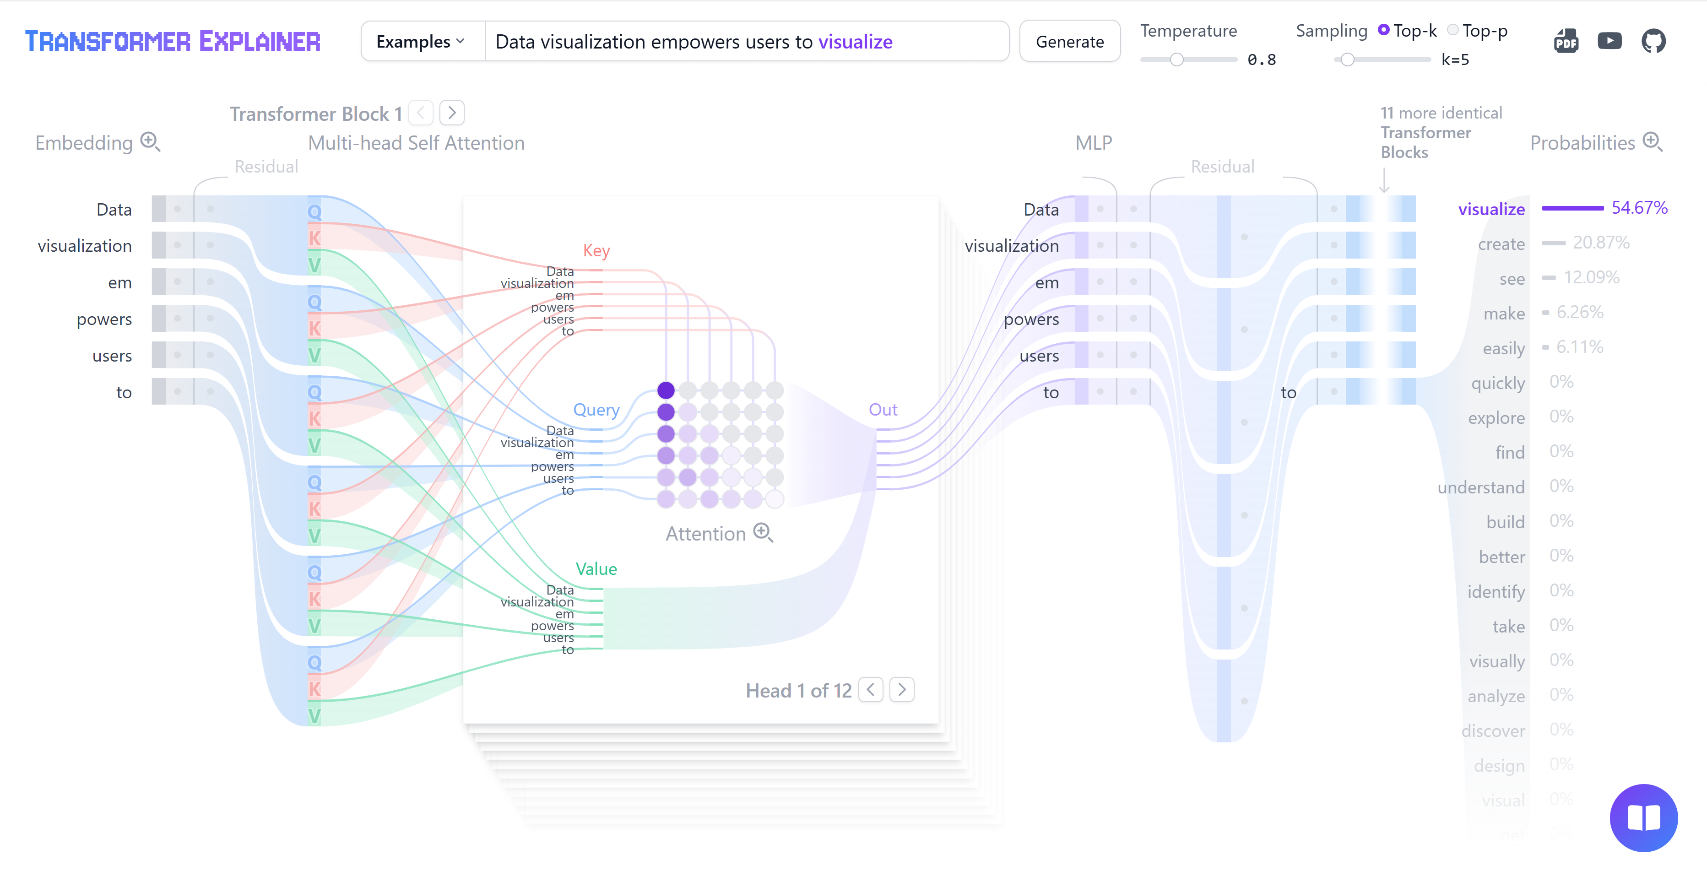
GPT-2 Architecture
11 transformer block
12 attention head

Slide 14
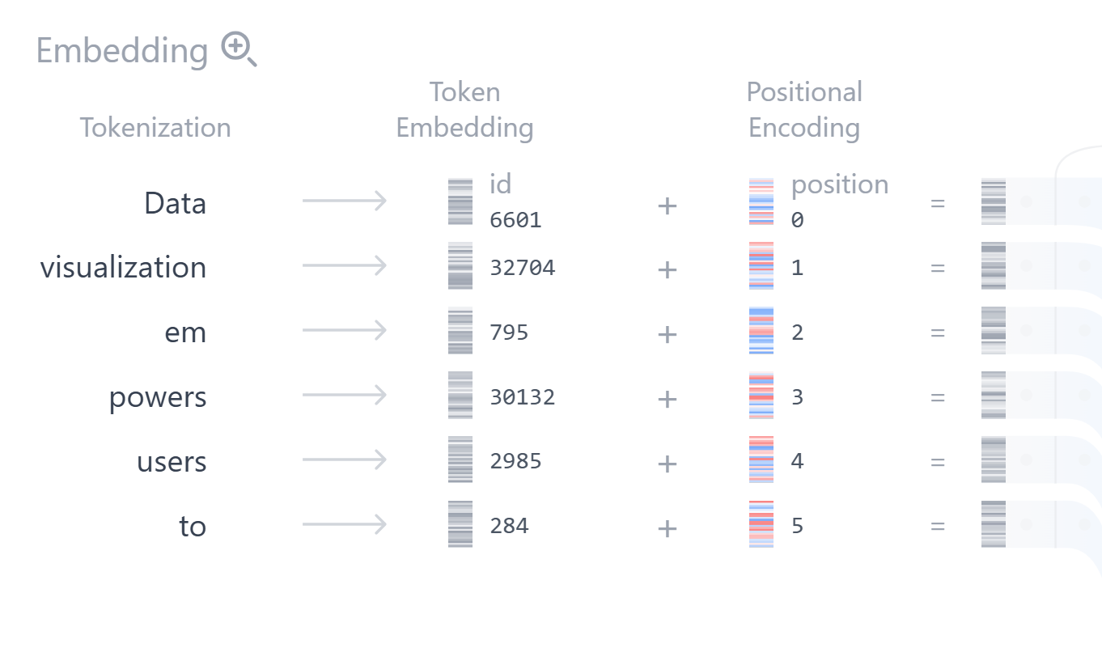
Tokenizer and embedding
50,257 vocab size
768 embedding size

Slide 15
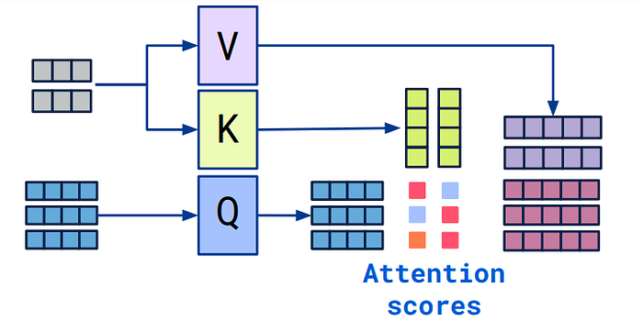
Self-Attention Mechanism
Allows the model to focus on relevant parts of a sentence
Computes Query, Key, Value vectors
Multi-head attention improves expressiveness
Enables context understanding over long text

Slide 16
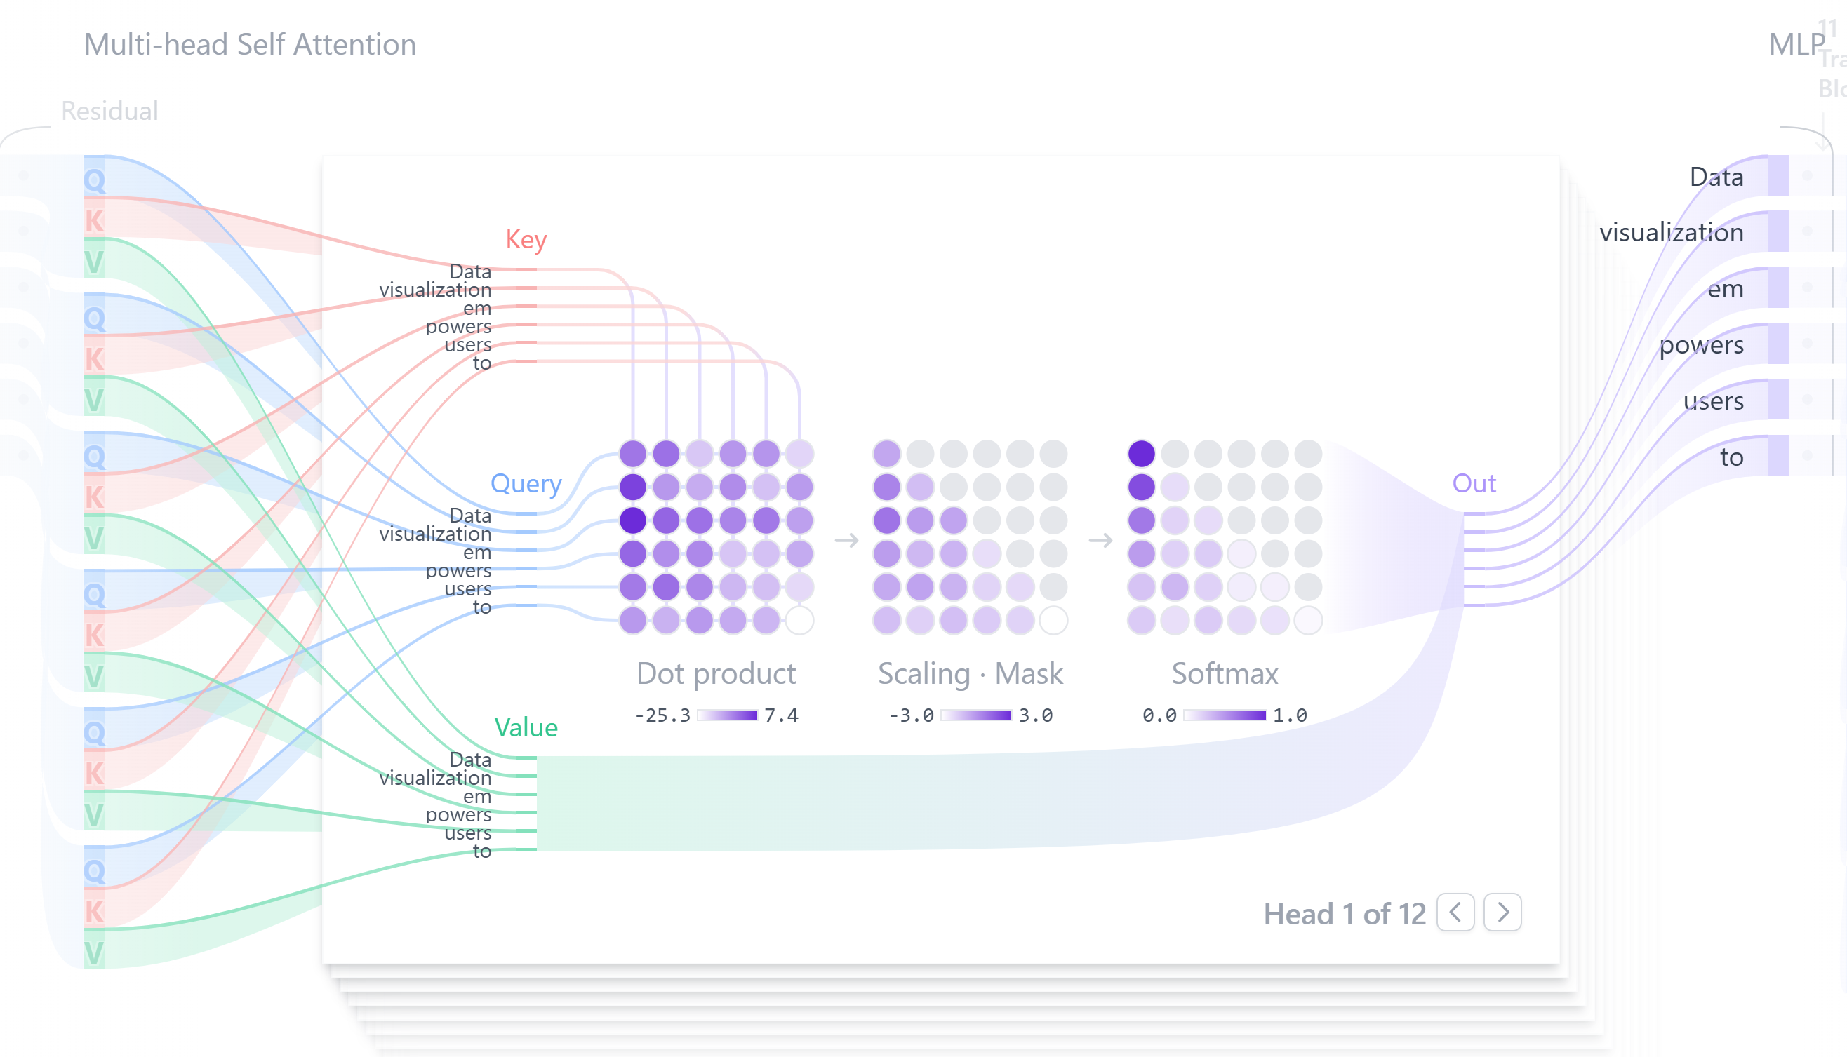
Attention

Slide 17
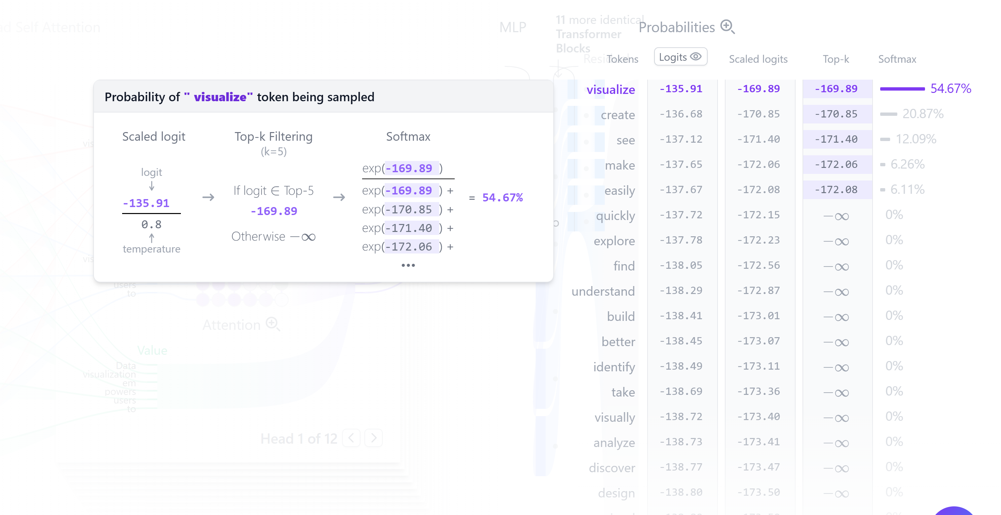
decoder
Softmax func
Probabilistic output

Slide 18
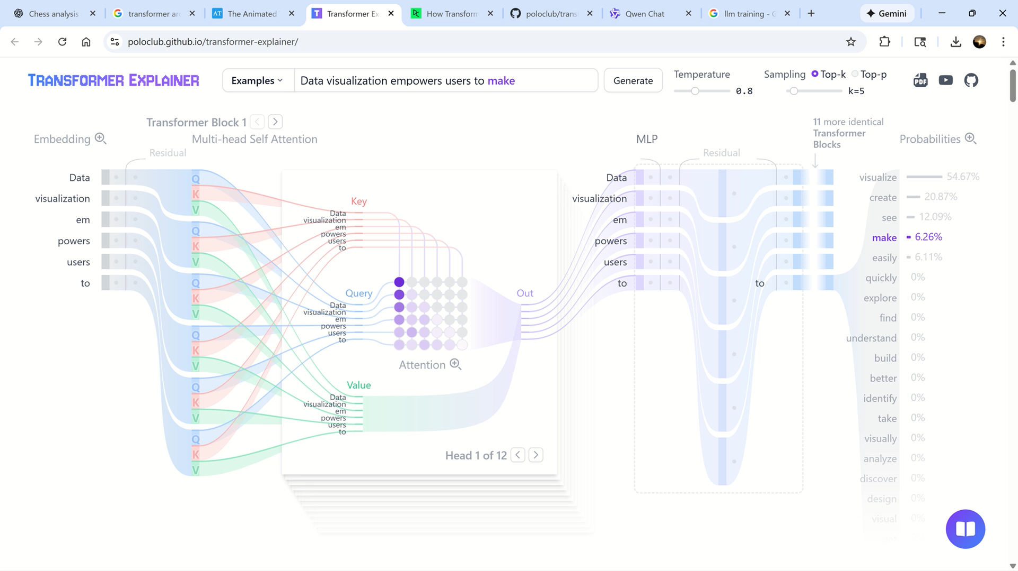

Slide 19
How LLMs Are Trained
Trained on massive corpora (web, books, code)
Objective: predict next token (autoregressive)
Fine-tuning for specific tasks (chat, coding, summarization)

Slide 20
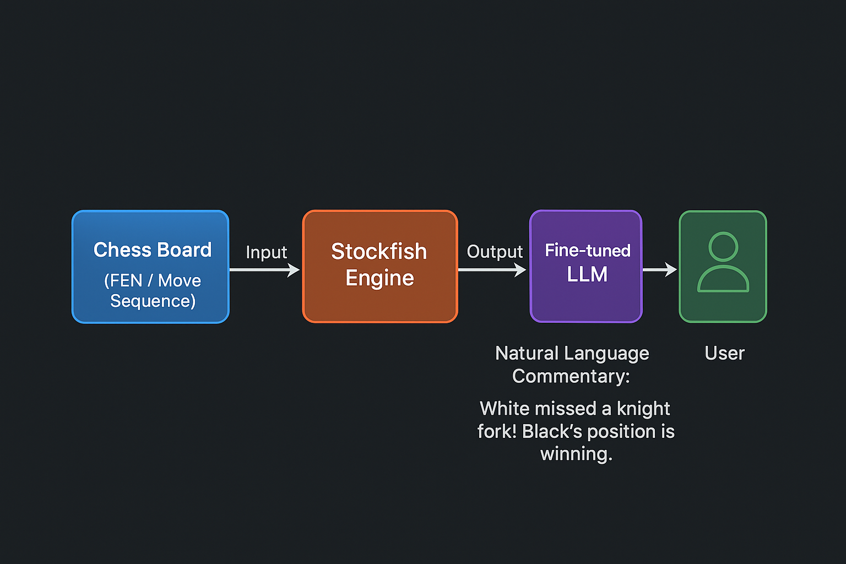
How can combine them

Slide 21
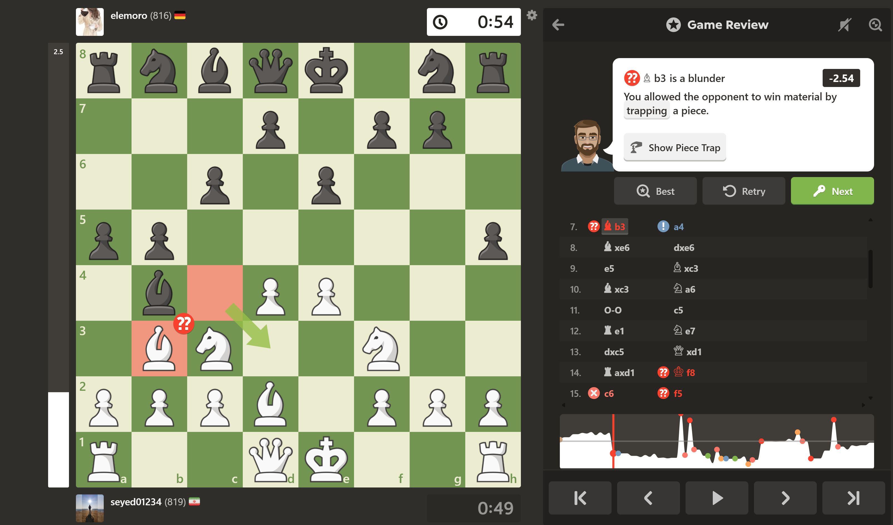
Real example

Slide 22
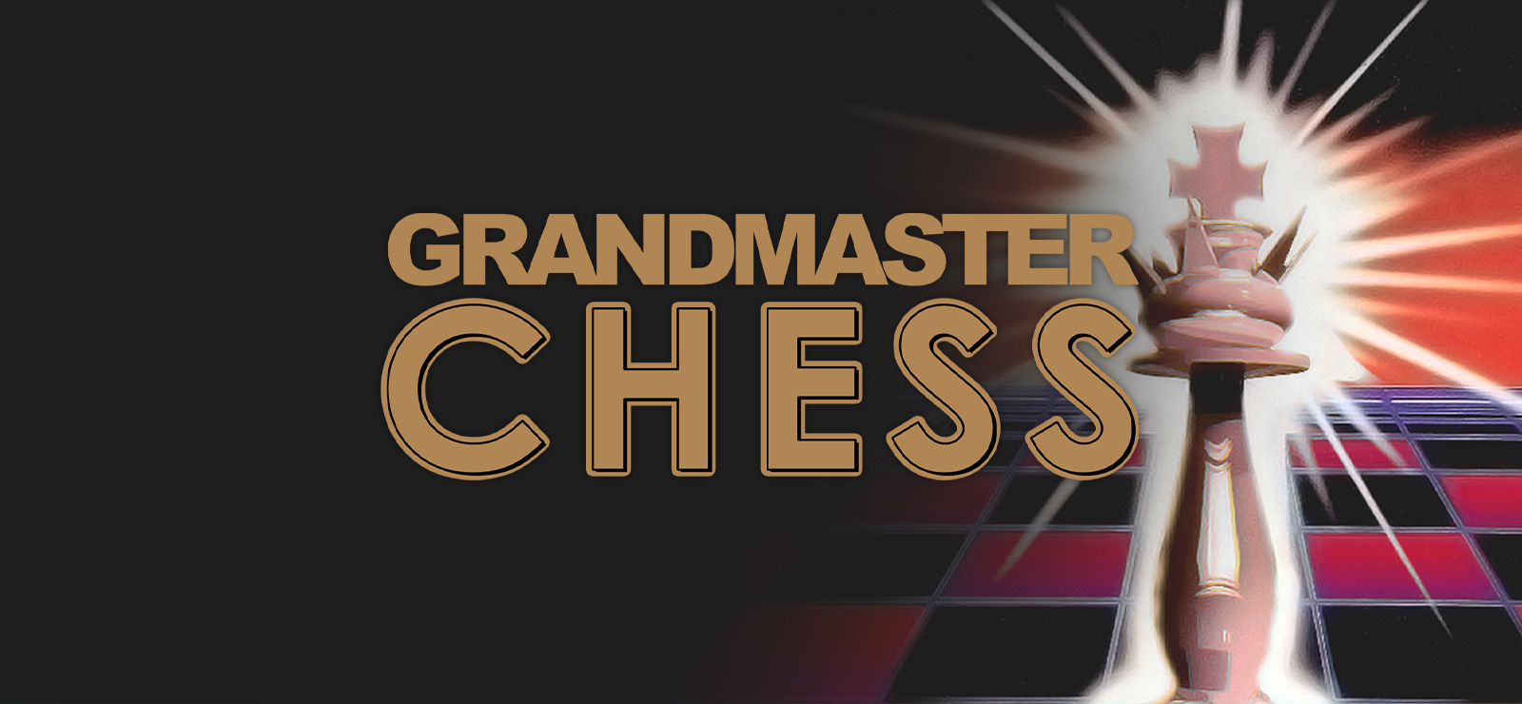
Conclusion
Neural models + symbolic/expert systems = more reliable, interpretable, and useful intelligence.

Slide 23
Acknowledgments

Slide 24
References
1. Deep Blue
Campbell, M., Hoane, A. J., & Hsu, F.-H. (2002). Deep Blue. Artificial Intelligence, 134(1–2), 57–83.
Hsu, F.-H. (2002). Behind Deep Blue: Building the Computer that Defeated the World Chess Champion. Princeton University Press.
2. Stockfish / Classical Search Engines
(No formal Stockfish paper exists — these cover classical engine methods & evaluation models used by engines like Stockfish)
3. AlphaZero
Silver, D., Hubert, T., Schrittwieser, J., et al. (2018). A General Reinforcement Learning Algorithm that Masters Chess, Shogi, and Go through Self-Play. Science, 362(6419), 1140–1144.
Schrittwieser, J., et al. (2020). Mastering Atari, Go, Chess and Shogi by Planning with a Learned Model. Nature, 588, 604–609.
4. Transformer Architecture & LLM Foundations
Vaswani, A., Shazeer, N., Parmar, N., et al. (2017). Attention Is All You Need. Advances in Neural Information Processing Systems (NeurIPS).
Devlin, J., Chang, M.-W., Lee, K., & Toutanova, K. (2019). BERT: Pre-training of Deep Bidirectional Transformers for Language Understanding. NAACL-HLT.
Brown, T., Mann, B., Ryder, N., et al. (2020). Language Models Are Few-Shot Learners. NeurIPS, 33.
5. Neural Network Evaluation for Chess (NNUE / learned eval)
Yamazaki, Y. (2020). Efficiently Updatable Neural Network Architecture for Shogi Evaluation Functions. ACM Transactions on Intelligent Systems and Technology (original NNUE concept).
6. General Computer Chess Theory
Levy, D. N.-L. & Newborn, M. (1991). How Computers Play Chess. Computer Science Press.
Marsland, T. (1986). Computer Chess and Search Strategies. IEEE Computer, 19(12), 78–86.

Slide 25
Thank you

